Slide 1
ECE 4211 UCONN-ECE (FCJ)
LW3 Lecture Week 3-2 (01312017)
Chapter 2 P-n and n-p junctions: (Continued)
Carrier recombination under forward biasing: Photon emission
Energy Band Diagrams
I-V equation using stored charge approach
Junction width and junction capacitance
Diffusion Capacitance
Circuit models
Reverse biasing: carrier distribution profiles
Avalanche and Zener Breakdown
Tunnel Diodes and their applications in solar cells and FETs
Heterojunctions (Built-in voltage V_{bi}, I-V equation)
Energy band diagram for single and double heterojunctions

Slide 2
Carrier recombination and photon emission: (see also LEDs and Lasers)
Radiative (photon emission) and non-radiative transitions: Since hole belongs to the valence band and the electrons to the conduction band, the recombination of an electron-hole pair results in energy release. When the energy is released as a photon, the transition is called radiative. On the other hand, when the energy released as phonons (or lattice vibrations) it is nonradiative, and causes heating of the material.
Number of photons produced per second (in a region defined by x) depends on the current I_{p}(x).
The total number of photons produced per second in n-region is I_{p}(x_{n})* η_{q}/q.
Quantum efficiency h_{q} defines the ratio of probability of a radiative transition.
It is expressed as η_{q} = (1/τ_{r})/[(1/τ_{r}) + (1/τ_{nr})], here, τ_{r} and τ_{nr} are the radiative and non-radiative lifetimes.
The quantum efficiency is higher in the direct energy gap semiconductors than in indirect energy gap semiconductors. It takes longer for an electron-hole pair to recombine in indirect energy gap semiconductors as they need the assistance of a phonon to conserve the momentum.
Both energy and momentum are conserved in a downward transition, such as that occurs when an electron-hole pair recombines. In direct energy gap semiconductors, the recombination via photon emission is more likely than in indirect semiconductors, such as Si and Germanium. In indirect energy gap semiconductors, the electrons and holes have different momentum or wave vectors (k). [Momentum is related to k via the Planck’s constant; p=h/λ=(h/2p)k].

Slide 3
Extraction of emitted photons
Photons have comparable energy (E=hν) ) to electrons and holes. However, they have very small momentum when compared to them. As a result, photon absorption and emission, involving electrons and holes, are shown by vertical lines on the E-k diagram (or energy band diagram). By contrast, lattice vibrations or phonons travel with the speed of sound, and have very small energy (~20 to 80 milli electron volt). But their momentum is comparable to that of electrons and holes. As a result phonons play a crucial role in transitions involving photons in indirect transitions.
Extraction of generated photons: once the photons are generated they travel in different directions. Depending on the application, sometime we want to stay inside a cavity (lasers) or move along waveguides (photonic integrated circuits) and other times we want to extract them out (light-emitting diodes, LEDs). See the section on wave guiding layers to configure LEDs as lasers.

Slide 4
2.5.7 Energy band diagrams under forward and reverse biasing: Fig. 10 shows energy band diagrams for equilibrium, forward bias and reverse biasing conditions. We outline steps to obtain these diagrams:
Step 1. Draw a straight line and call it Fermi energy under equilibrium (dashed line).
Step 2. Draw two vertical lines representing junction. Note that the equilibrium width W_{o} (left figure) is larger than forward bias diode (center W_{f}) and smaller than the reverse biased diode (W_{r} right).
Step 3. Draw new Fermi level in the neutral p-semiconductor with respect to the n-semiconductor. There is no change in equilibrium or left figure. Under forward bias, p-region is qV_{f} lower than the equilibrium value as shown in the center figure. In forward bias of 0.2V, p-side is positive, but the electron energy band diagram is 0.2eV below the equilibrium Fermi level. The case is opposite in the reverse bias of -0.2V. Here, p-side is V_{r} = -0.2V negative with respect to n-side, but the new Fermi level is 0.2eV higher than the equilibrium level.
Step 4. Draw valence band and conduction band on the p-side using new Fermi level.
Step 5. Join conduction bands and valence bands between the two vertical lines.

Slide 5
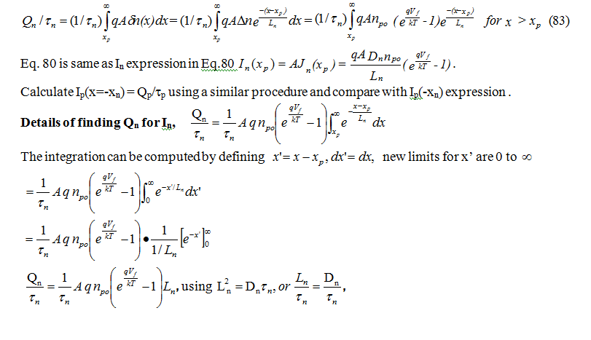
2.5.4Alternate approach to derive I-V equation using stored charge:
In this approach, the charge stored in the p- and n-regions is computed. The current is stored charge divided by the average lifetime of the injected minority electrons in the p-region of the n-p diode. In an n-p diode,
I_{n}(x=x_{p}) = Q_{n}/τ_{n} (82)
here, Q_{n} is the excess minority charge stored in the p-region. Current I_{n}(x_{p}) is obtained by integrating qδn(x) [to find charge Q_{n}] and diving by life time τ_{n}.

Slide 6
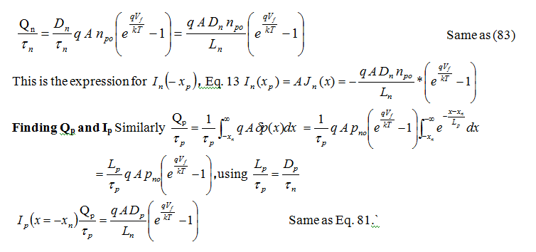

Slide 7
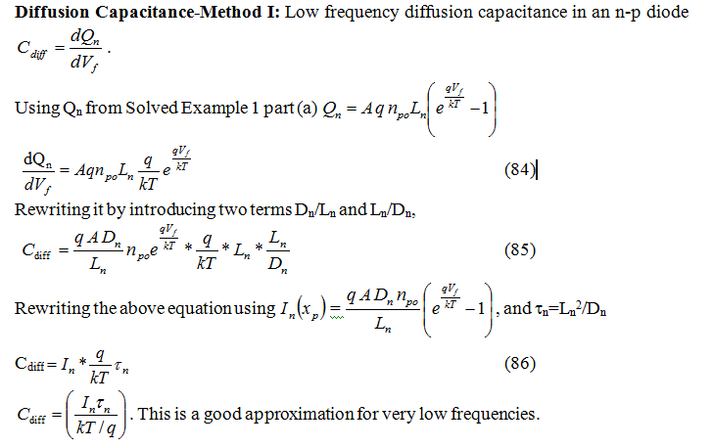
2.5.5 Diffusion capacitance:
When the diode is forward biased, the stored minority carrier charges in the neutral regions varies with the applied voltage, and contribute to a capacitive component known as diffusion capacitance C_{diff}.

Slide 8
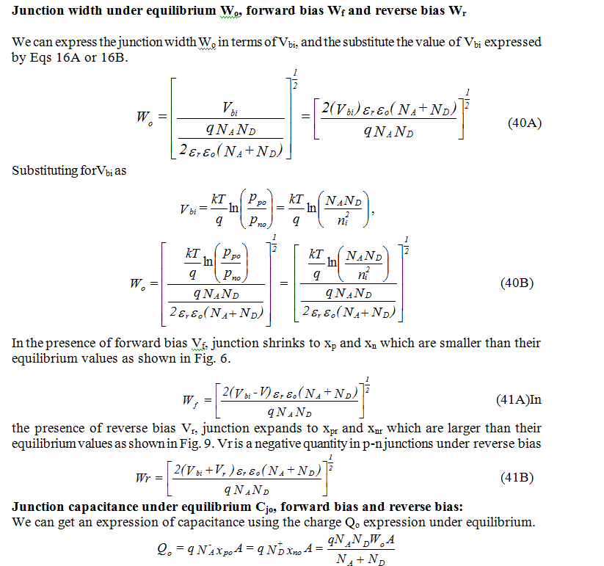
Junction width and Junction Capacitance p.106

Slide 9
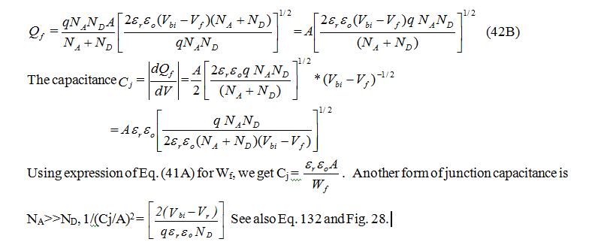
Substituting Eq. 40A for W_{o}, we get
And under forward bias
Diffusion Capacitance-Method I: Low frequency diffusion capacitance in an n-p diode (page 119)
Diffusion Capacitance- Method II: Eq. 91
C_{diff}
(86)
Y(jω) = q[(D_{p}/L_{p}) p_{no} (1+jωτ_{p})^{1/2} + q(D_{n}/L_{n}) n_{po} (1+jωτ_{n})^{1/2} ](1/v1+ q/kT) (91)
2.5.5.1 Circuit Model for Diodes:
Conductance G_{D} may be added with ac resistance r_{e}
r_{e} = dV_{f}/dI= (kT/qI).

Slide 10
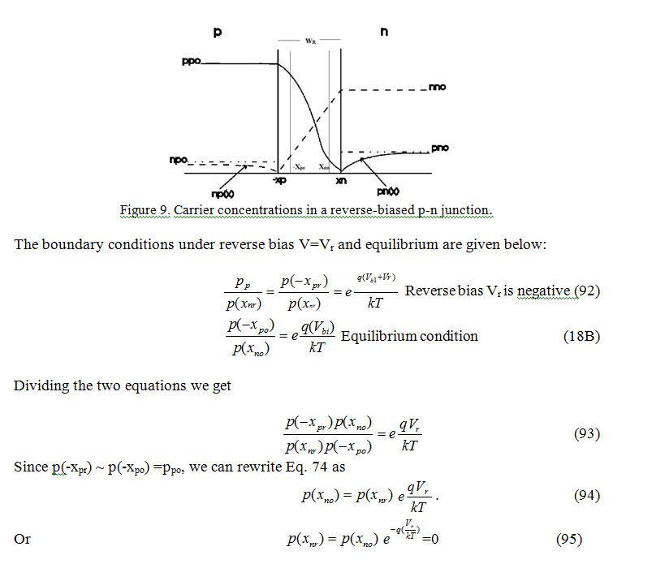
Reverse bias junction: Carrier distribution

Slide 11

Carrier distribution in a reverse biased p-n junction
UConn-ECE4211, F. Jain
Week 3-Lecture 2 02102015
J_{p}(x_{n}) = - [(q D_{p} p_{no})/L_{p}],
J_{p}(x) = J_{p}(x_{n})
, for x>x_{n}
J_{n}(x) = -[(q D_{n} n_{po})/L_{n}]
Thus the current under reverse biasing is
J = - J_{s},
where J_{s} is the reverse saturation current J_{s}.
The second boundary condition shows that
B=0 otherwise we have a solution which is not realistic.
The first boundary condition gives
A = -p_{no}
This gives
p_{n}(x)=δp(x) + p_{no}= p_{no}(1-
for x>x_{nr}
Here, x_{n} should be replaced by x_{nr}
J_{p}(x) = q D_{p} p_{no} (-1/L_{p})
= - [(q D_{p} p_{no})/L_{p}]
The current density at x= x_{n} or x_{nr}
J_{p}(x_{n}) = - [(q D_{p} p_{no})/L_{p}],

Slide 12
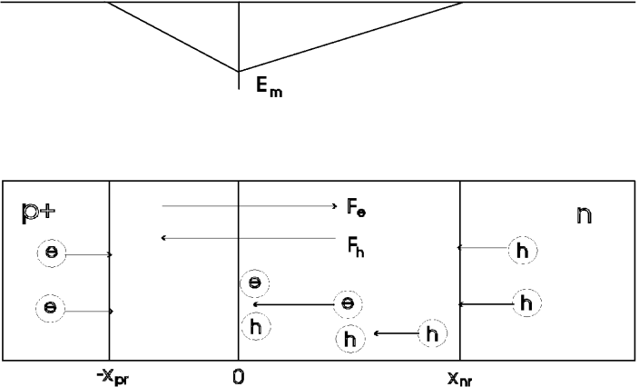
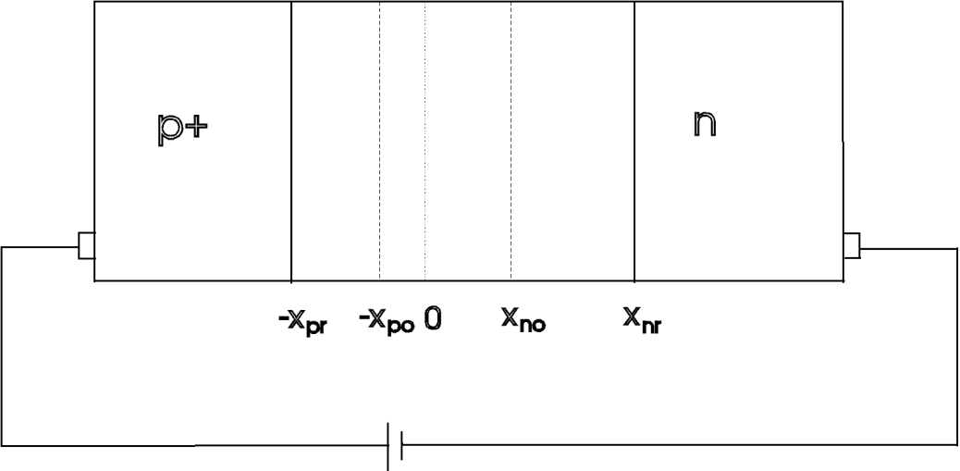
2.6 Avalanche and Zener Breakdown in Reverse-Biased p-n Junctions (p.125)
Figure 11(a). Reverse biased p+-n junction.
Figure 11. (b) E-field distribution, 11 (c) Electron-hole pair generation by accelerating holes

Slide 13
Avalanche Breakdown p-n Junctions
(107)
Figure 11. (c) Current flow in diodes; (top) p-n junction with width W and p-i-n with W’ (bottom).
The avalanche generation rate
α = electron ionization coefficient and β = hole ionization coefficient.
Case I: β << α and β=0

Slide 14
Avalanche Breakdown p-n Junctions
(107)
Fig. 11(d) . Variation of the electron hole current components in the depletion region.
Case I: β << α and β=0

Slide 15
2.6.2 Zener Breakdown from energy band perspective
Fig. 12 shows schematically the energy band diagram under equilibrium and reverse baised conditions. W_{r} represents the width of the potential barrier for electrons on p-side. Electron can tunnel through the potential barrier Wr if it is around 50-100Å. This field-assisted tunneling gives rise to Zener breakdown. If the field assisted tunneling is negligible, then the device follows avalanche breakdown.
(107)
N_{A}>> N_{D}

Slide 16
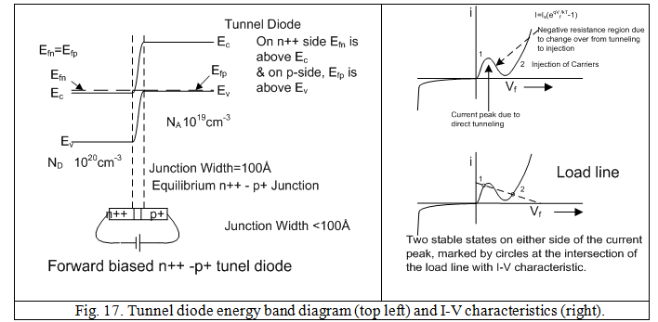
2.7 Tunnel diodes:
Figure 17 shows the energy band diagram of a tunnel diode. Since diode n-side (left) and p-side (right side) are heavily doped, Fermi levels are above E_{c} and below E_{v}. That is inside the bands. They are not in the energy gap as we usually show. The thin barrier also increases the tunneling probability. Fig. 18A shows tunneling in more detail.

Slide 17
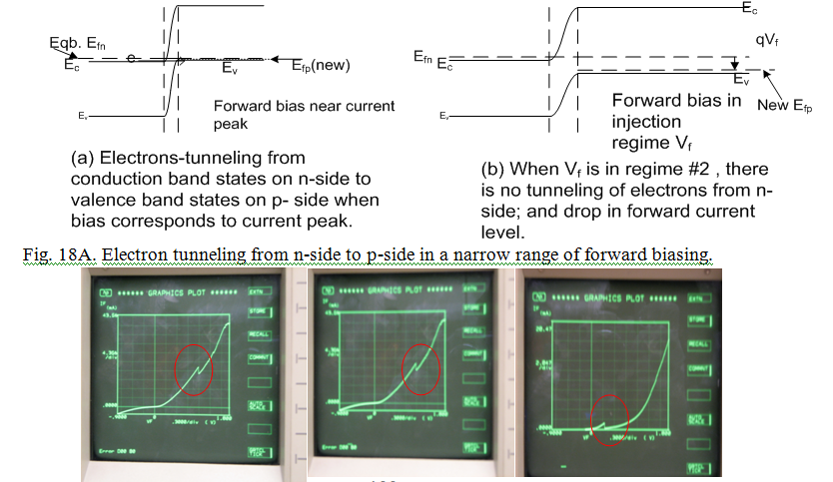
2.7 Tunnel diodes: page 132

Slide 18
Application of Tunnel Junctions: Solar Cells
Fig. 18C Tunnel junction interfacing two n-p cells. Here, the bottom n-p GaAs cell and top n-p GaInP cell.

Slide 19
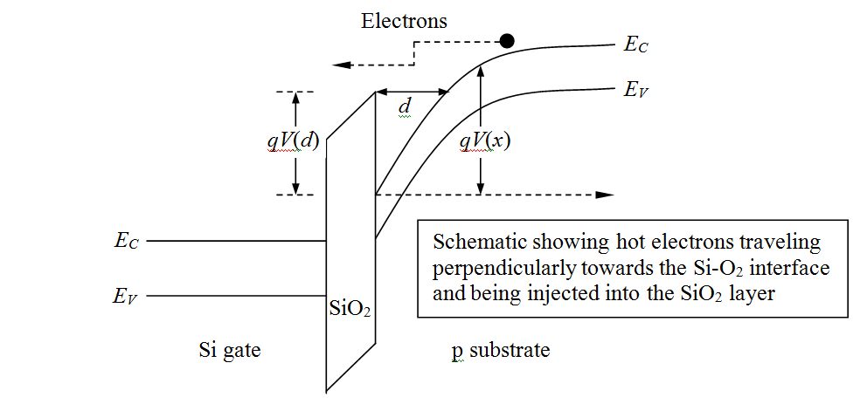
Application of Tunnel Junctions: FETs
Fig. 20C Electrons tunneling from the inversion channel to the gate in a MOSFET.
Example Fowler-Nordheim tunneling (The potential barrier has a slope due to the presence of the voltage drop across oxide SiO₂).
In MOS-FETs, source to drain tunneling takes place when channel lengths are very small and barrier heights are small.

Slide 20
Heterojunctions: Single heterojunction
2.9.5. Single heterojunctions: Energy band diagrams for N-AlGaAs – p-GaAs and P-AlGaAs/n-GaAs heterojunctions under equilibrium
Fig. 35. Energy band diagram per above calculations. N-p heterojunction.
Fig. 36. Energy band diagram for a p-n heterojunction.

Slide 21
Energy band diagram: Double Heterojunction
Fig. 39. A forward biased NAlGaAs-pGaAs-PAlGaAs double heterojunction diode.
Fig. 42 Energy band diagram of a NAlGaAs-pGaAs-PAlGaAs double heterostructure diode.

Slide 22
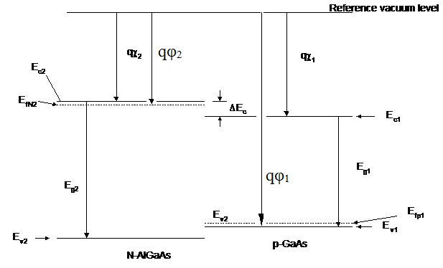
Built-in Voltage in Heterojunctions
Fig. 33. Energy band diagram line up before equilibrium.

Slide 23
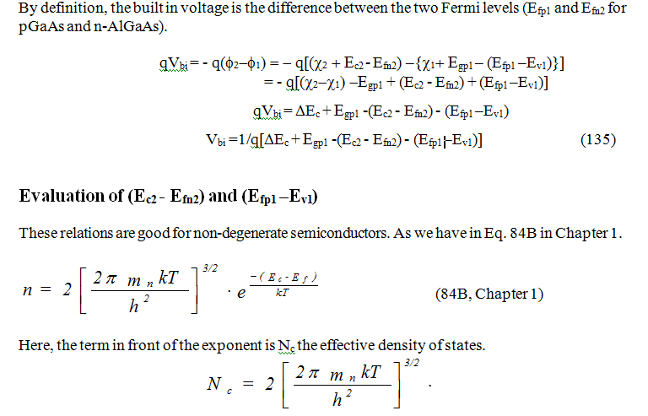
Built-in Voltage in Heterojunctions

Slide 24
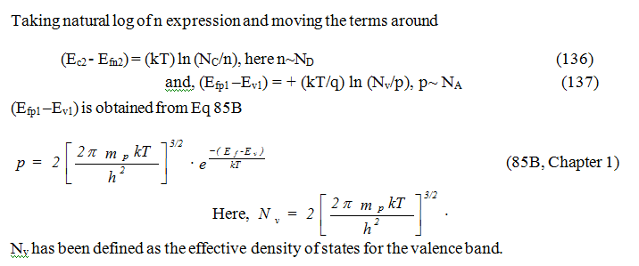
Built-in Voltage in Heterojunctions Cont.

Slide 25
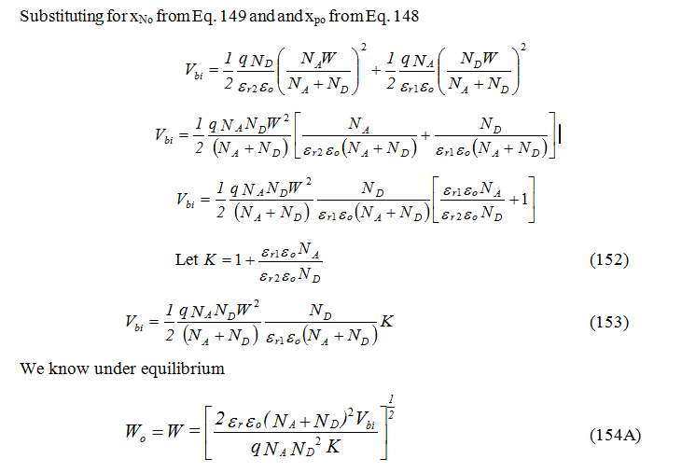
2.9.3.2. Built-in Voltage Method II: Gauss' Law
(145)

Slide 26
2.9.4. Forward-Biased NAlGaAs-pGaAs Heterojunction
Fig.34 Carrier concentrations in an n-p heterojunction
Electron diffusion from N-AlGaAs to the p-GaAs side,
Hole diffusion from pGaAs to the N-AlGaAs,
(73)
(162)
(161)
(164)

Slide 27
I-V Equation
Next we substitute the values of n_{po} and p_{No} in Eq. 107
(170)

Slide 28
I-V Equation and Current Density Plot
Here, we have used the energy gap difference ΔE_{g}=E_{g2}-E_{g1}. From Eq. 174 we can see that the second term, representing hole current density J_{p} which is injected from p-GaAs side into N-AlGaAs, and it is quite small as it has [exp-(ΔE_{g}/kT)] term.
As a result, J ~ J_{n}(x_{p}), and it is
Fig. 38B Current density plots.

