Slide 1
UConn L11 11082016 ECE 5212
Photodetectors

Slide 2
Mechanisms
7.1 Photon Detection
Introduction:
Photon detection is achieved using various phenomena listed below:
Photon effects: Involving photon-electron interaction. Photon effects are further divided into internal and external categories. When photogenerated carriers remains inside the material, we call it internal photo effects. They are:
Internal
Photoconductivity
Photovoltaic
Photoelectromagnect (PEM)
Dember-effect
Phototransistor & photodiodes
Free carrier interaction
Free carrier absorption (wavelength longer than corresponding to the E_{g}
Photon drag: Electrons are pushed in the direction of the Poynting vector. Thus a longitudinal electric field is established which can be detected by having electrons.

Slide 3
2. The external one includes:
Conventional photocathode
Negative affinity semiconductor photocathode
Thermal effects: Temperature variation changing the crystalline properties. Thermal effects based devices include:
Bolometers
Pyroelectric
Thermoelectric
Liquid crystal (Smectic, cholersetric)
Wave interaction effects: Interaction of the incident electromagnetic field with the sensing material.
Optical heterodyne
Optical parametric
Josephson
Metal-barrier metal
Super Schottky diodes

Slide 4
7.2 Principle of Detection
Noise associated with detection.
Forms of detection:
Signal noise limited
Background noise limited
Noise mechanism in an ideal detector:
Figure of merit of a detector:
NEP Noise equivalent power

Slide 5
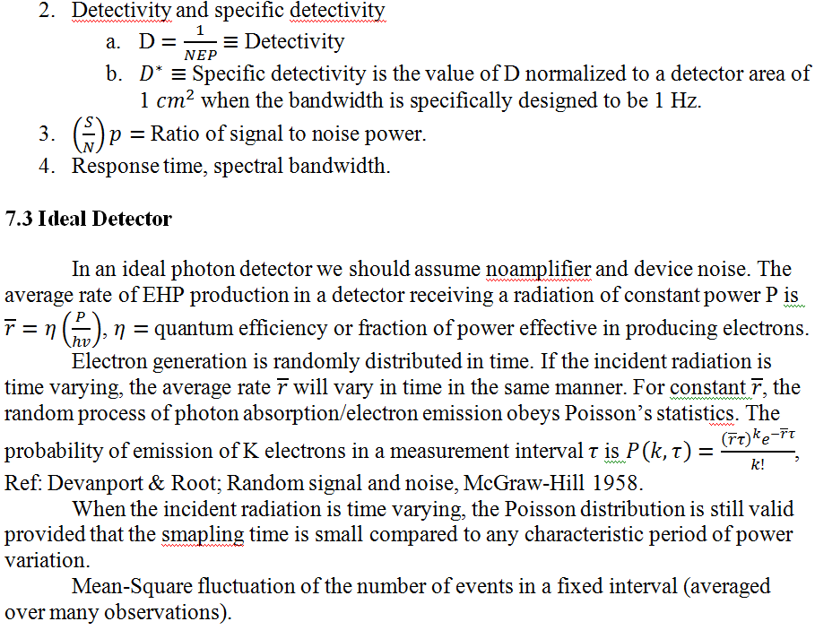

Slide 6
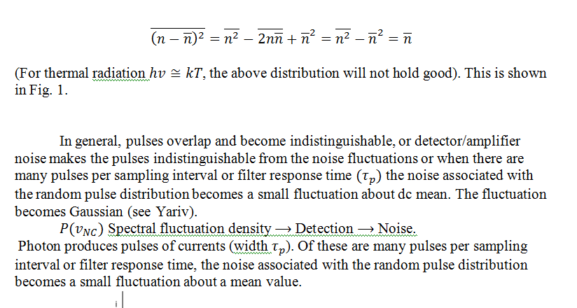

Slide 7
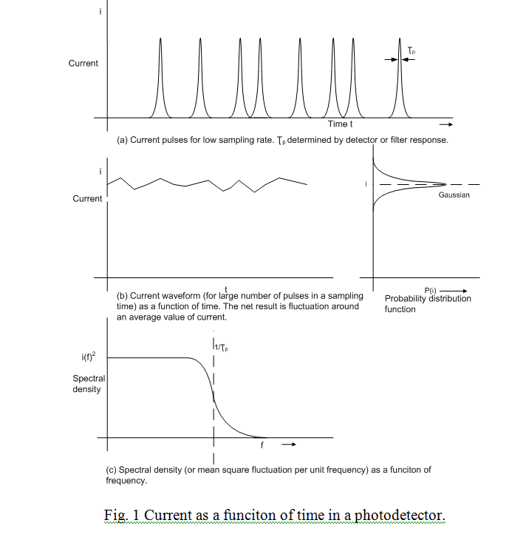

Slide 8
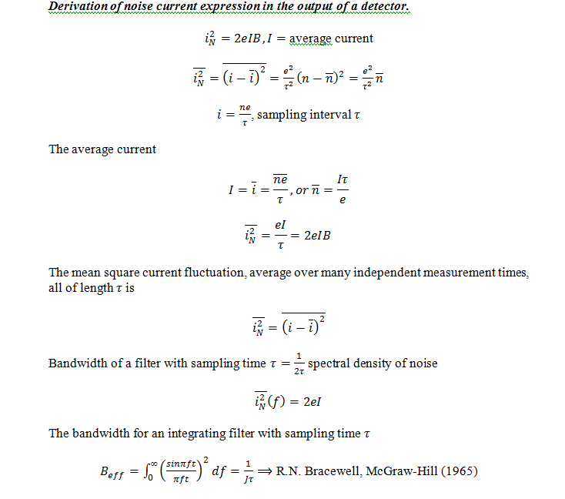

Slide 9
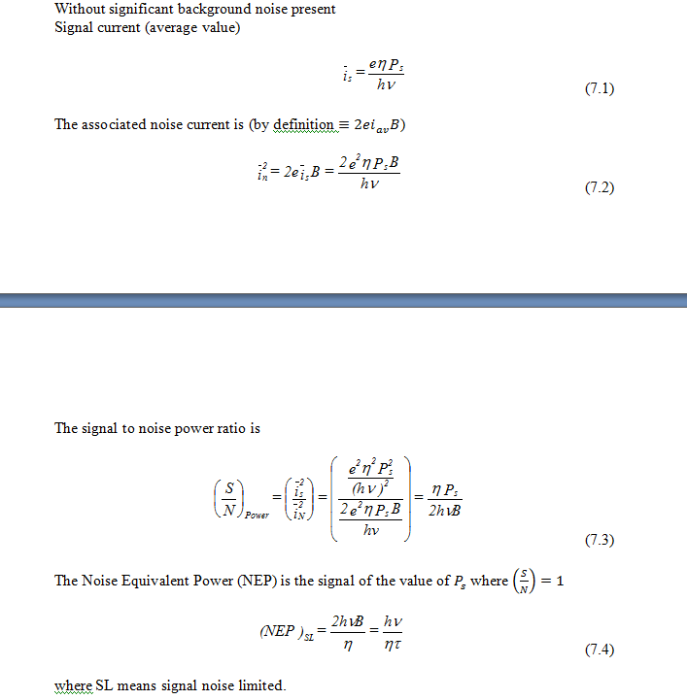
7.4 Signal Noise-Limited Detection

Slide 10
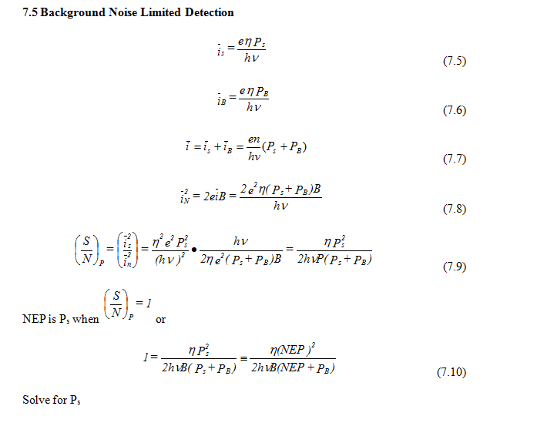

Slide 11
