Slide 1
DC and Stepping Motor Basic
DC and Stepping Motor Control Circuit
Sung Yeul Park
Dept. Electrical & Computer Eng
Center for Clean Energy Engineering
University of Connecticut
Email: supark@engr.uconn.edu

Slide 2
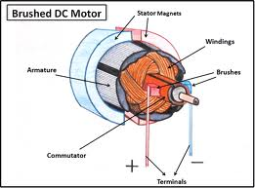
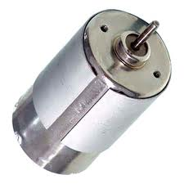
DC Motor
A DC motor is an electric motor that runs on direct current (DC) electricity. DC motors were used to run machinery, often eliminating the need for a local steam engine or internal combustion engine. DC motors can operate directly from rechargeable batteries, providing the motive power for the first electric vehicles. Today DC motors are still found in applications as small as toys and disk drives, or in large sizes to operate steel rolling mills and paper machines. Modern DC motors are nearly always operated in conjunction with power electronic devices.
http://en.wikipedia.org/wiki/DC_motor

Slide 3
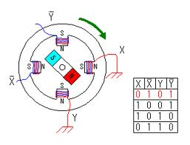
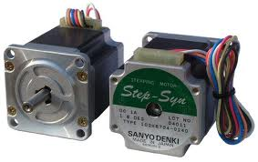
Stepper Motor
A stepper motor (or step motor) is a brushless DC electric motor that divides a full rotation into a number of equal steps. The motor's position can then be commanded to move and hold at one of these steps without any feedback sensor (an open-loop controller), as long as the motor is carefully sized to the application.
http://en.wikipedia.org/wiki/Stepper_motor

Slide 4
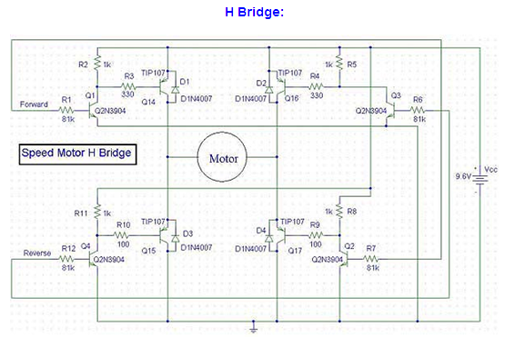
DC Motor Control Circuit: H Bridge(1)
http://people.ece.cornell.edu/land/courses/ece4760/FinalProjects/s2000/ameer/index.htm

Slide 5
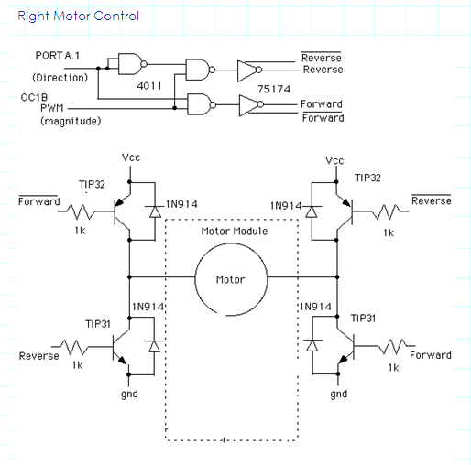
DC Motor Control Circuit: H Bridge(2)
http://people.ece.cornell.edu/land/courses/ece4760/FinalProjects/s2001/dmc47/home.htm

Slide 6
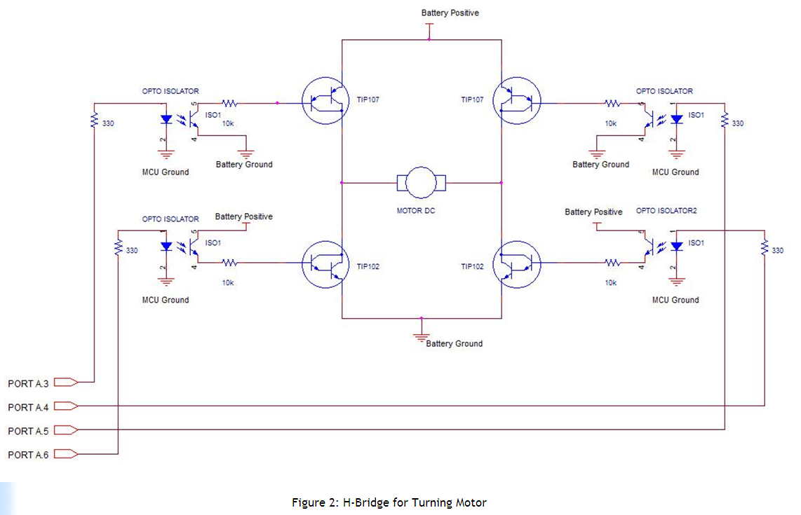
DC Motor Control Circuit: H Bridge(3)
http://people.ece.cornell.edu/land/courses/ece4760/FinalProjects/s2007/bl222_wh84/bl222_wh84/index.html

Slide 7
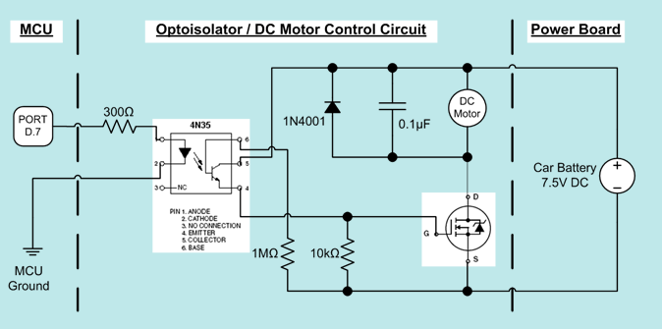
DC Motor Control Circuit: H Bridge(4)
http://people.ece.cornell.edu/land/courses/ece4760/FinalProjects/s2011/bcc44_acl84_my259/bcc44_acl84_my259/index.html

Slide 8
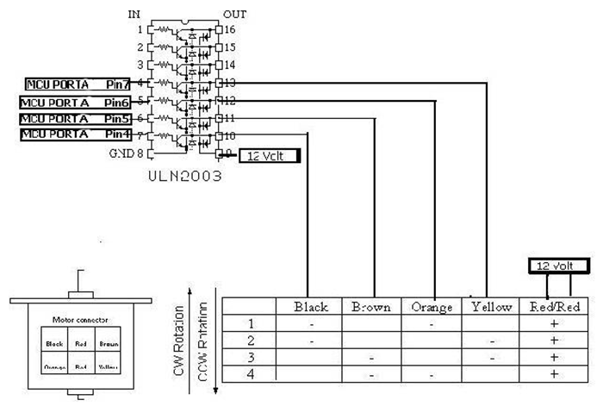
Stepping Motor Control Circuit(1)
http://people.ece.cornell.edu/land/courses/ece4760/FinalProjects/s2001/apk4/hardware.html

Slide 9
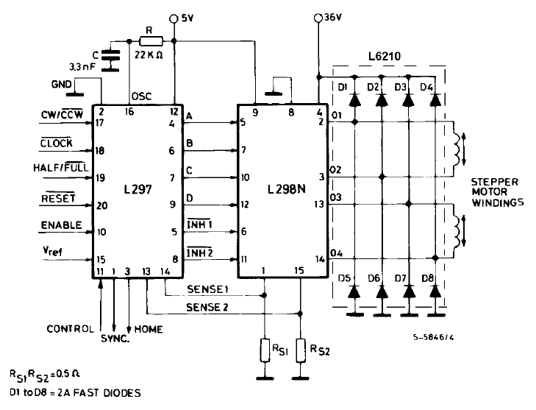
Stepping Motor Control Circuit(2)
http://people.ece.cornell.edu/land/courses/ece4760/FinalProjects/s2009/kk383_sl486/kk383_sl486/datasheets/l297.pdf

Slide 10
